Slide 1
Locomotion System General Notes
Plan of Attack
Kinematic Parameters and E.o.M.'s
Control Strategies
Motion Planning Strategies
References

Slide 2
Locomotion System: Expectations
Preferably, an omnidirectional system driven by Mecanum wheels (45 deg "Swedish Wheel") or similar system,
Locomotion System must be able to navigate workshop,
Locomotion System must be stable when holding a pose in workspace and must not be easily removed from said pose for safety and stability reasons.
Locomotion System must have body velocity constraints and collision detection for safety of workers and working environment,
Locomotion System must rely on sensor system (vision lidar? system) for obstacle avoidance,

Slide 3
Plan of Attack
Kinematic Equations
High Level Path Planner
Low Level Path Planner
Body/Wheel Dynamics
Trajectory/Posture Controller
Wheel Kinematics
FK Equations of Motion for Body
Weights/Moments of Inertia of Body and Buffers
Required Wheel Torques and Size
Must be able to follow a Trajectory
Must be able to Stabalize in a certain Pose or even Lock position
Internal map of workshop
Path Plans from Point A to Point B
Follow User while maintaining specified distance
Obstacle Detection and Avoidance via Sensor System
Find Optimal Pose relative to Goal within local area
Follow a specific mode of control (of the 3 options later mentioned)
Mathematical Modelling Design Phase
Controller Design Phase
Motion Planning Design Phase

Slide 4
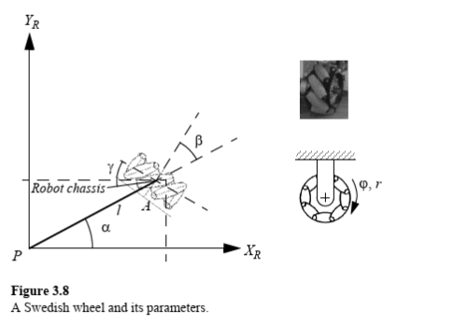
Mathematical Modelling Design Phase
The total weight of the robot body (including arm and tool storage), an additional buffer weight for tool/part (< 10 lbs) transportation and the Angular Moment of Inertia (of robot body and buffer mass) must be known to calculate necessary accelerations to and from desired velocities (from body velocity to wheel velocities).
Develop the Kinematic Equations of Motion
Kinematic Design Constraints:
Angular Velocity Control of each wheel,
Zero DoF of robot body when wheels set to Angular Velocity of Zero.
Swedish (Mecanum) Wheels
Develop the Dynamic Equations of Motion
Dynamic Design Constraints:
Wheel motors must be capable of providing the necessary velocities for omnidirectional movement (which direction requires greatest velocity?).
Fig. 1: {Diagram Taken from Ref. [1]}
- Ref. [1] Chapter 3, "Mobile Robot Kinematics," gives detailed explanation of wheel parameters, rolling/sliding constraints, and how to set up equations of motion for mobile robots

Slide 5

Mathematical Modelling Design Phase (Conti.)
Modelling Design Constraints:
Is the kinematic model reasonable when the dynamic model is applied? [I.e. are the wheels big enough? do the rollers need to be wider for better traction? what is the max vel's/acc's required from wheels?]
Required Equations/Parameters (Refer to next slide):
Kinematic Equations of Motion [4 Wheel Velocity Inputs -> Body Velocity {linear & angular} outputs {change in position and orientation}]
Wheel Positions w.r.t. body
Wheel Parameters {refer to Table 1}
Body Mass Parameters {Body Mass, Body Moment of Inertia} - TBD
Modelling: Expectations:
A MATLAB script that takes the desired body pose/velocities, and outputs the necessary wheel velocities and torques needed for execution
Can the kinematic model be used for control? And the dynamics be covered by the servomotors (motor provides necessary torque to reach velocity...)? -> Only need dynamic model when accelerations are constrained which shouldn't be a problem due to low body velocity limit.

Slide 6
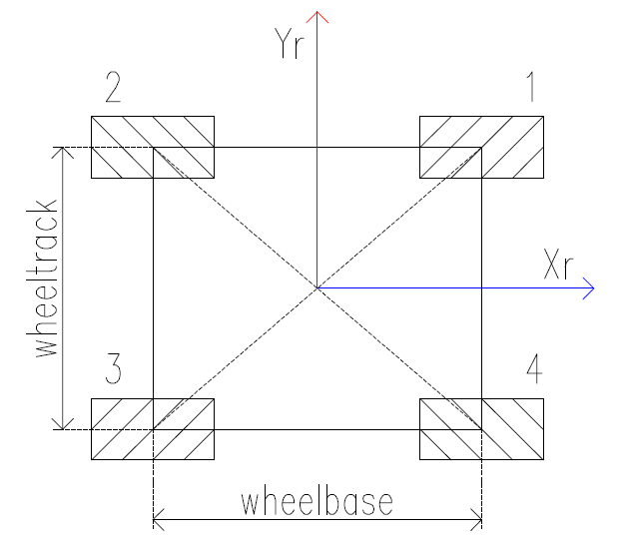
Robot Chassis Parameters/Configuration
Wheel | Alpha i | Beta i | Gamma i
1 | tan⁻¹(whl_track/whl_base) | pi/2 - alpha_1 | 3*pi/4
2 | pi - tan⁻¹(whl_track/whl_base) | 3*pi/2 + alpha_1 | pi/4
3 | pi + tan⁻¹(whl_track/whl_base) | 3*pi/2 - alpha_1 | 3*pi/4
4 | 2*pi - tan⁻¹(whl_track/whl_base) | 5*pi/2 + alpha_1 | pi/4
Table 1: Wheel Parameters
l | sqrt(whl_track² + whl_base²) /2
r | ​r
m, I | body mass, moments of Inertia
Whl_base | 0.535 m
Whl_trck | 0.459 m
Fig 2: {Taken from Ref. [1]}
- Ref. [1] Ch. 3, "Mobile Robot Kinematics," gives detailed explanation of wheel parameters, rolling/sliding constraints, and how to set up equations of motion for mobile robots
Table 2: Additional Parameters
Fig. 3: Robot Chassis Configuration

Slide 7
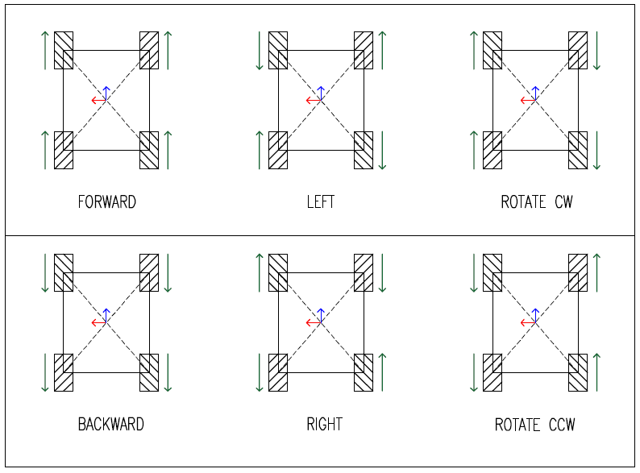
Robot Chassis Kinematics Equations (E.o.M's) and Directional Control Modes
Mecanum (Swedish) Wheel Rolling Constraint:
[-sin(α+β+gamma), cos(α+β+gamma), l*cos(β+gamma)]*R(theta)*xidot + [r*cos(gamma)]*phidot = 0
Combined Rolling Constraints (Matrix Form):
J₁* R(theta) * xidot + J₂ * phidot = 0
Forward Kinematics:
xidot = R(theta)⁻¹ * J₁⁻¹ * (- J₂) * phidot
Inverse Kinematics:
phidot = J₂⁻¹ * (- J₁) * R(theta) * xidot
FIG. 4: Directional Control Modes
[VERIFY WITH KINEMATIC MODEL]

Slide 8
Locomotion System Dynamics
General Method of Approach for Future Design...
Ref. [2] for methodology....
Leave this out or just mention Ref. [2] for a more robust dynamic modelling methodology.

Slide 9
Controller Design Phase
Developing Trajectory/Pose Control:
Trajectory/Pose Control Constraints:
Small Steps,
Error Driven Control, (or disturbance driven for "Push/Pull" Mode)
Must stop if [Collision Value] is passed into it {sets all Desired Values to current position w/ zero body velocity, then executes local obstacle avoidance} until [Collision Value] is cleared, then resets Desired Values to closest trajectory coordinate [CONCEPT NEEDS TO BE FLUSHED OUT]. Must be Asymptotically Stable around Final Velocity Constraints.
Control Mode Options:
"Autonomous Retrieval" - (Control is driven by Trajectory Error)
"Push/Pull" - User Guided (Control is driven by Disturbance)
"Follow the Leader" - (Control is driven by Positional Error Tolerance (w/in radius of worker),{"Object Tracking" Example in Mobile Robotics Toolbox[4]})
Proposed Control Method: Static State Feedback (should be able to achieve both posture and trajectory control for omnidirectional robots)

Slide 10
Safety Features/Requirements
Max Body Velocity: 1.5 m/s (Linear), 4.25 rad/s (Angular)
Auto-Stop Features (Pause when Obstacle is unavoidable and plan path otherwise?)
Collision Detection? What happens when it collides??? Or when a sensor stop's working? Should the main system be notified and the Control Mode default to User-Guided?

Slide 11
Current To-Do list (3/12/2022)
Build 3 Controllers as shown below
Auto. Path Follower – Pure Pursuit Method w/ Vector Field Driven Obstacle Avoidance: Need to finish connecting Lidar and Replace Pure Pursuit Block w/ our method
IN Progress - Build Simulink Model to follow General Flow Chart Shown Below
Obstacle Detection / Emergency Stop
Pose
Autonomous Path Following Controller
Path Planner
Follow the User Path Controller
User Position
Simulator (FK)
Visualizer
Disturbance / Manual Control Signal
Manual Controller
Control Mode Selector
(includes IK)

Slide 12
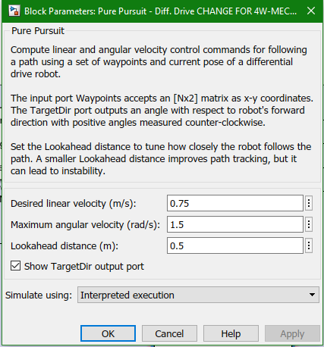
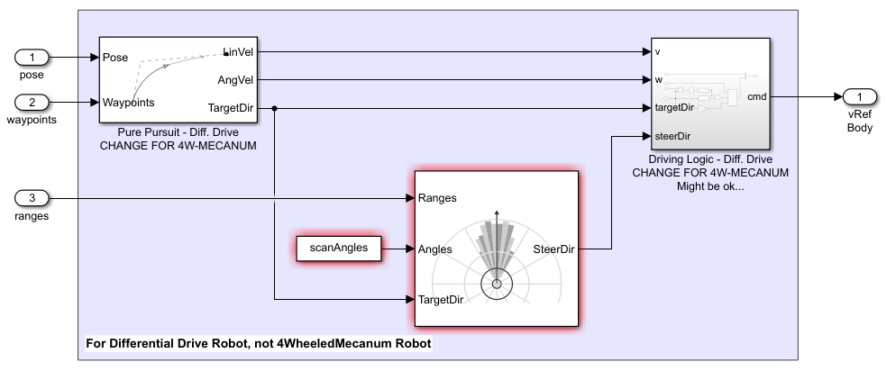
Autonomous Path Following Controller
*Pure Pursuit Controller*** should work. Review Controller Limitations
here: https://www.mathworks.com/help/robotics/ug/pure-pursuit-controller.html
** Driving Logic Block Needs Changing
*** State Feedback For Local Stability
W/ Vector Field Histogram Obstacle Avoidance
Use "Pure Pursuit" Block* that takes in Current Pose and Waypoints (Path) and generates desired Velocity (Linear Speed, Angular Speed, and Target Heading with one for Omnidirectional Robot**
Ref. [6] or [7] for Trajectory Control!!!!!!

Slide 13
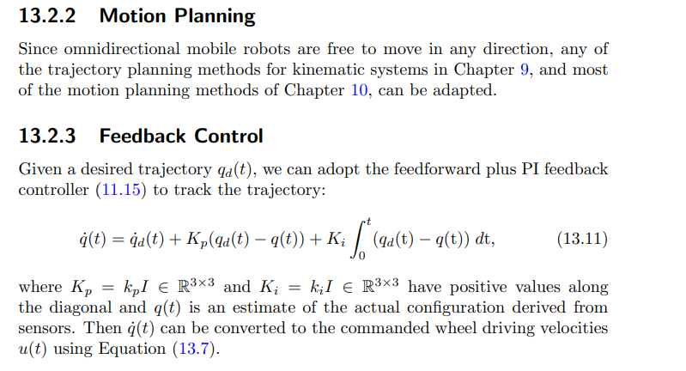
Autonomous Path Following Controller (conti.)
Ref. [7] Chapter 13 (Modern Robotics)

Slide 14
Follow-the-User Controller
Look into "Object Tracking" Simulink Example
Need to include Obstacle Avoidance via Vector Field Histogram and Pure Pursuit Method...?

Slide 15
User-Guided Control (manual control)
Can use Simulink's Sliders to emulate Joystick/Knob Control of {Xr,Yr,Thetar}
Scale down Control Inputs to Max Body Velocity Limits and plug into IK to give Wheel Control Signals (Desired Wheel Velocities)

Slide 16
Mobile Robot Simulation Toolbox Notes
"Object Detector" block – recognizes an object (ex. camera system recognizes user as object)
"Lidar Sensor" block – helps recognize obstacles in map
Control Modes - Simulink Examples included in Toolbox
Path-Follower Controller - "Waypoint following and obstacle avoidance" Example
Follow the Leader Controller - "Object tracking logic" Example
User Guided Controller – no example, but use disturbance or joystick control

Slide 17
Motion Planning Design Phase
Developing Path Planning System (May need just waypoints as Output, use "map data" to plan)
Path Planning Modes: "Follow the Leader" - robot maintains a certain distance {or must stay within radius} from person it is following, "Seek Destination" - autonomously achieve a pose within configuration space, "Obstacle Avoidance and Path Revision" - encounters obstacle, moves around, and finds new shortest path to goal (A* Planner?)
Collision Detection Constraints: Active Collision Detection driven by Vision System {and maybe excessive motor torque or trajectory control failure}, Passive Collision Detection - staying away from "no-go" zones either pre-written in map or through visual recognition, or taken care of by [Vector Field Histogram]?????????
Path Planning Constraints: Must feed Trajectory Controller a Desired Pose/Trajectory, Must have a general path planner, must have an obstacle avoidance path planner {maybe works this into a controller of sorts that only activates when collision detection registers an obstacle},
Motion Planning: Expectations
A MATLAB/Simulink script that takes current body pose/velocities and desired action, generates high-level path plan, and then executes path plan within some simulation environment while avoiding obstacles [preferably, in tandem with vision system sensors]

Slide 18
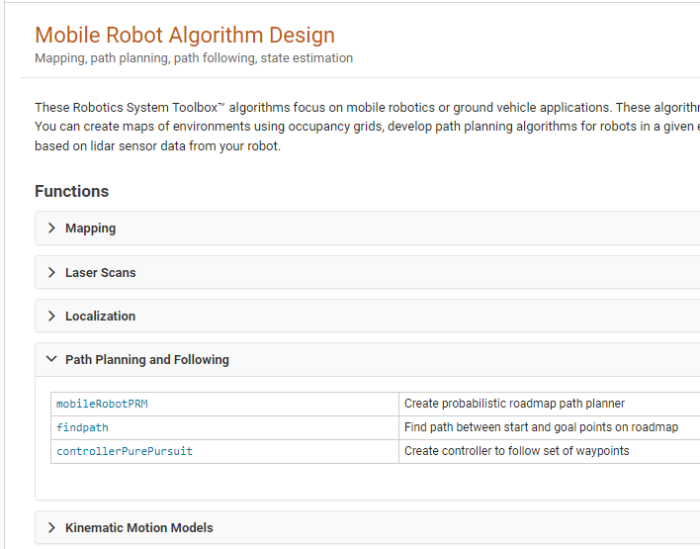



Motion Planning Design Phase (Trajectory Generation)
Build a Probabilistic Road Map (PRM)
Generate a Path of Waypoints
Use Waypoints to generate a Trajectory
Ref. [4]

Slide 19
Localization Problem
Assume localization problem is solved and cause negligible error using a map-based navigation system
Mapping: User-guided or Full Coverage Path Planner to accomplish Mapping of Environment for General Path Planning Use later. Localize via Camera and Map data, but how???
Refer to Chapter 5 of [1] for an overview of various localization techniques
In report, suggest several applicable methods that would be worth pursuing given our set of sensors
Method 1:
Method 2:
Method 3:

Slide 20

Simulation Objectives
Inputs: current values or set of data
pose (x, y, theta),
wheel vel./torque (4x omega₁₋₄ or 4x tau₁₋₄),
time (t)
Map/obstacle/sensor info (data array)
Outputs: animated execution of robot navigation
Showing robot's change in position
Showing all wheel velocities/torques (arrow vectors in orientation of wheels?)
Visuals:
Animation
Wheel velocity/torque graphs
Overview of map and planned vs executed path
Disturbance info (TBD)
Show interactions with obstacles
Potential Simulation Environments [4]
https://www.mathworks.com/matlabcentral/fileexchange/66586-mobile-robotics-simulation-toolbox?s_tid=srchtitle_mobile%20robot_6

Slide 21
References/Resources w/ [MLA Bibliography]
[1] Introduction to Autonomous Mobile Robots
Siegwart, Roland, Illah Reza Nourbakhsh, and Davide. Scaramuzza. Introduction to Autonomous Mobile Robots. 2nd ed. / Roland Siegwart, Illah R. Nourbakhsh, and Davide Scaramuzza. Cambridge, Massachusetts: MIT Press, 2011. Print.
[2] Theory of Robot Control
Canudas de Wit, Carlos A., Bruno Siciliano, and Georges Bastin. Theory of Robot Control. 1st ed. 1996. London: Springer-Verlag, 1996. Web.
[3] Planning Algorithms
LaValle, Steven Michael. Planning Algorithms. Cambridge: Cambridge University Press, 2006. Print.
[4] Mobile Robotics Simulation Toolbox Algorithms
MathWorks Student Competitions Team (2022). Mobile Robotics Simulation Toolbox (https://github.com/mathworks-robotics/mobile-robotics-simulation-toolbox), GitHub. Retrieved February 27, 2022.
[5] Forward Kinematic Derivation of Mecanum Wheeled Robot
Hamid Taheri, Bing Qiao and Nurallah Ghaeminezhad. Article: Kinematic Model of a Four Mecanum Wheeled Mobile Robot. International Journal of Computer Applications 113(3):6-9, March 2015. Full text available.
[6] Trajectory Tracking Using Linear State Feedback Controller for a Mecanum Wheel Omnidirectional
Thai, Nguyen Hong et al. “Trajectory Tracking Using Linear State Feedback Controller for a Mecanum Wheel Omnidirectional.” Advances in Asian Mechanism and Machine Science. Vol. 113. Cham: Springer International Publishing, 2021. 411–421. Web.
[7] Modern Robotics: Mechanics, Planning, and Control (NEED MLA BIBLIOGRAPHY)
"Modern Robotics: Mechanics, Planning, and Control," Kevin M. Lynch and Frank C. Park, Cambridge University Press, 2017, ISBN 9781107156302, http://hades.mech.northwestern.edu/index.php/Modern_Robotics

Slide 22
Abstract

Slide 23
ARCHIVE (outdated or old slides)

